Slide 1


Vanshika Bhalla
15 March 2024

Slide 2

Outline
Executive Summary
Introduction
Methodology
Results
Conclusion
Appendix

Slide 3
Executive Summary
Summary of methodologies
Summary of all results

Slide 4
Introduction
Project background and context
SpaceX advertises Falcon 9 rocket launches on its website, with a cost of 62 million dollars; other providers cost upward of 165 million dollars each, much of the savings is because SpaceX can reuse the first stage. Therefore if we can determine if the first stage will land, we can determine the cost of a launch. This information can be used if an alternate company wants to bid against SpaceX for a rocket launch.
Problems you want to find answer
What is the price of each launch?
Will SpaceX reuse the first stage?
Will the first stage land successfully?

Slide 5

Section 1

Slide 6
Methodology
Executive Summary
Data collection methodology:
Collect the data from the official SpaceX API
Perform data wrangling
Extract tables and other data from the web page via scraping
Perform exploratory data analysis (EDA) using visualization and SQL
Perform interactive visual analytics using Folium and Plotly Dash
Perform predictive analysis using classification models
Use various models via GridSearchCV for classification

Slide 7
Data Collection
Describe how data sets were collected.
SpaceX Rest API, WebScraping from Wikipedia
OneHotEncoding data fields for ML
Data Cleaning and
You need to present your data collection process use key phrases and flowcharts.

Slide 8
Data Collection – SpaceX API
SpaceX launch data that is gathered from the SpaceX REST API.
The SpaceX REST API endpoints, or URL, starts with api.spacexdata.com/v4/.
Another source – Wikipedia using BeautifulSoup

Slide 9
Data Wrangling
Check null values
Calculate number of launches on each site
Calculate the number and occurrence of each orbit
Calculate the number and occurrence of mission outcome per orbit type.
Create a landing outcome label from Outcome column.
Handle null values.
https://github.com/VanshikaBhalla/capstoneDS/blob/main/Module1_2.ipynb

Slide 10
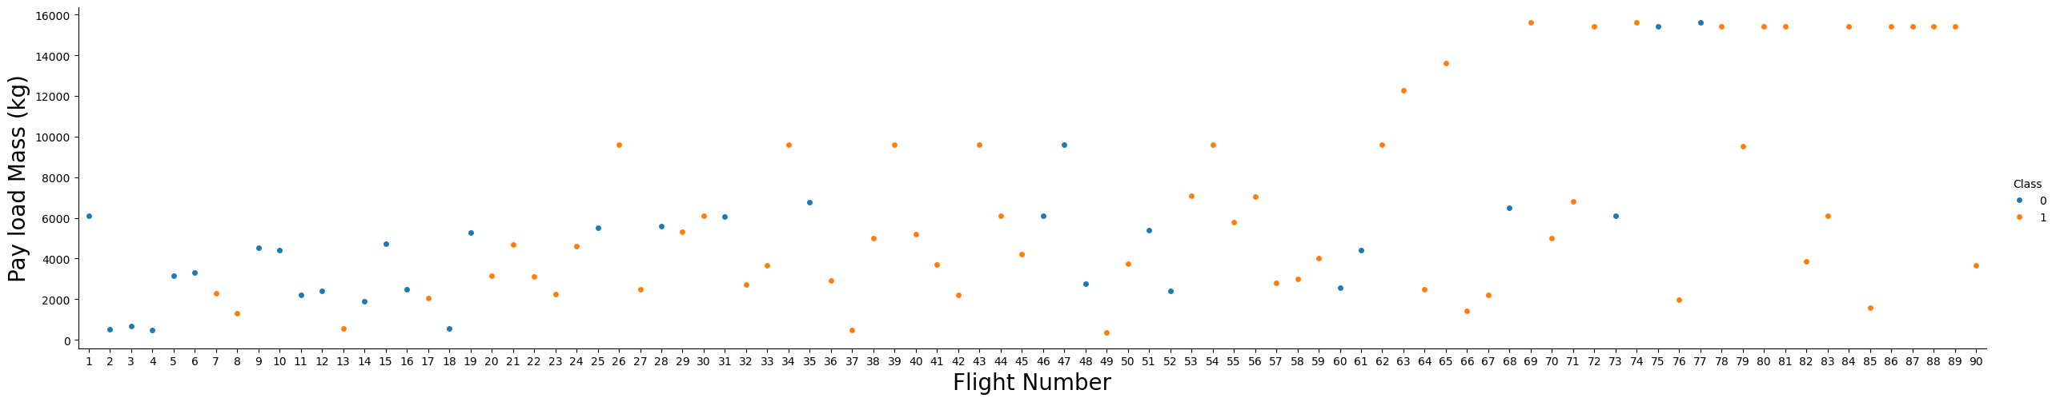
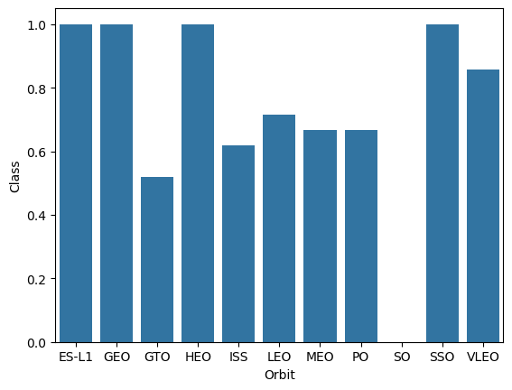
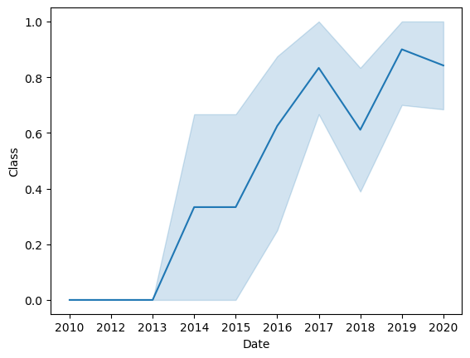
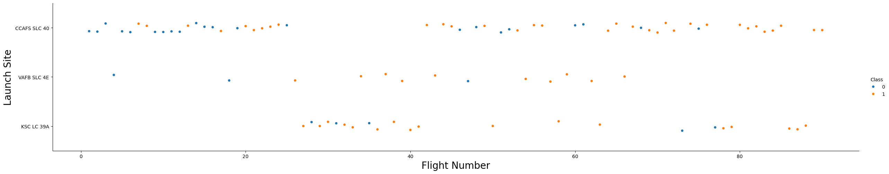
EDA with Data Visualization
https://github.com/VanshikaBhalla/capstoneDS/blob/main/edadataviz.ipynb

Slide 11
EDA with SQL
Displaying names of unique launch sites
Displaying sites with names starting with ‘KSC’
Displaying avg payload on various parameters
Etc.
https://github.com/VanshikaBhalla/capstoneDS/blob/main/jupyter-labs-eda-sql-coursera_sqllite.ipynb

Slide 12
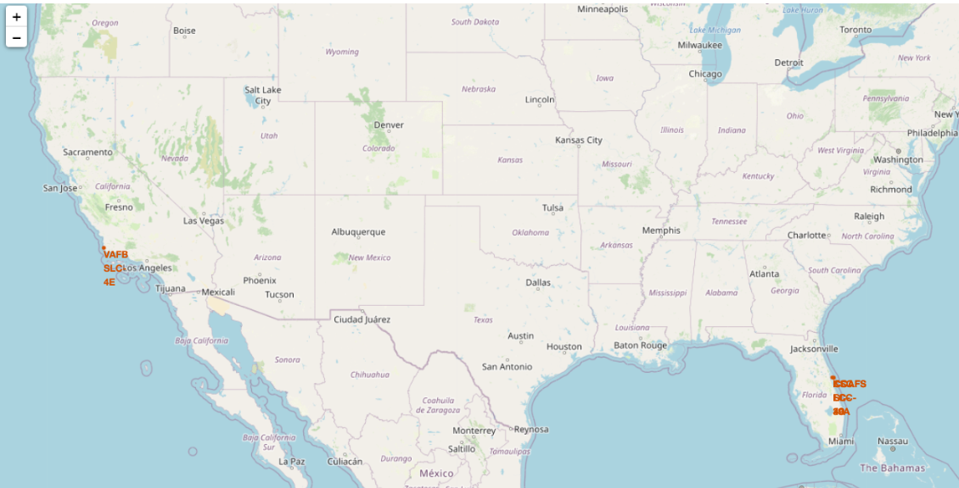
Build an Interactive Map with Folium
Map showing unique launch sites and other data
https://github.com/VanshikaBhalla/capstoneDS/blob/main/lab_jupyter_launch_site_location.ipynb

Slide 13
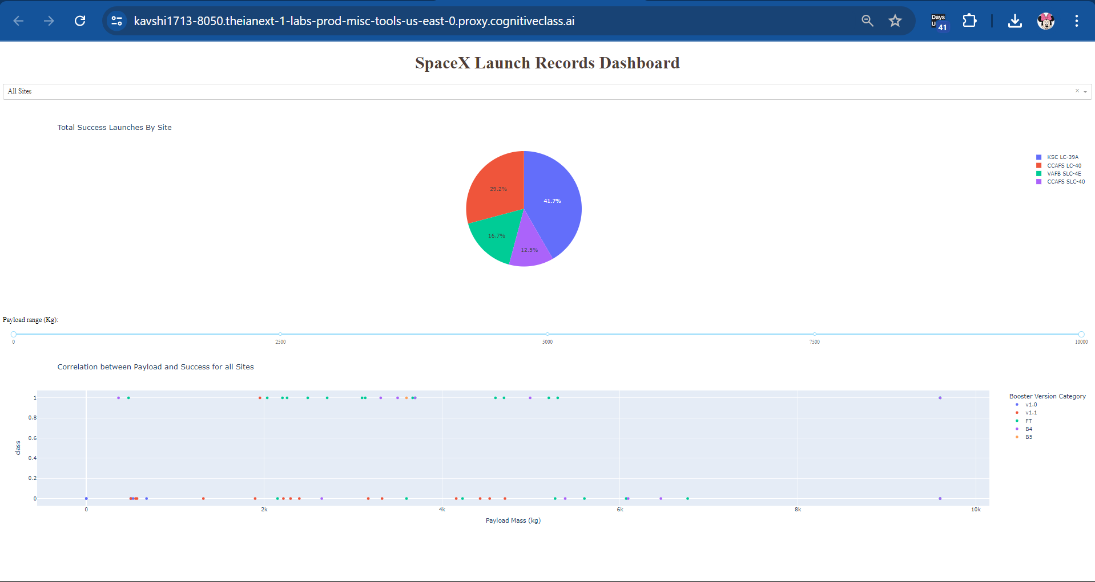
Build a Dashboard with Plotly Dash
https://github.com/VanshikaBhalla/capstoneDS/blob/main/spacex_dash_app.py

Slide 14
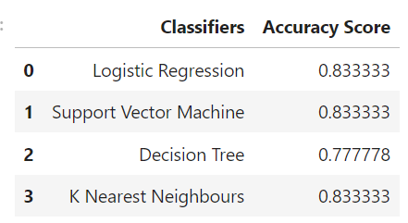
Predictive Analysis (Classification)
https://github.com/VanshikaBhalla/capstoneDS/blob/main/SpaceX_Machine%20Learning%20Prediction_Part_5.ipynb

Slide 15
Results
Prediction accuracy best in KNN, SVM and Logistic Regression models.
Low weighted payloads have better performance
KSC LC 39A had the max successful launches
Orbit GEO, HEO, SSO, ESL1 – best success rate

Slide 16

Section 2

Slide 17
Flight Number vs. Launch Site

Slide 18
Payload vs. Launch Site

Slide 19
Success Rate vs. Orbit Type

Slide 20
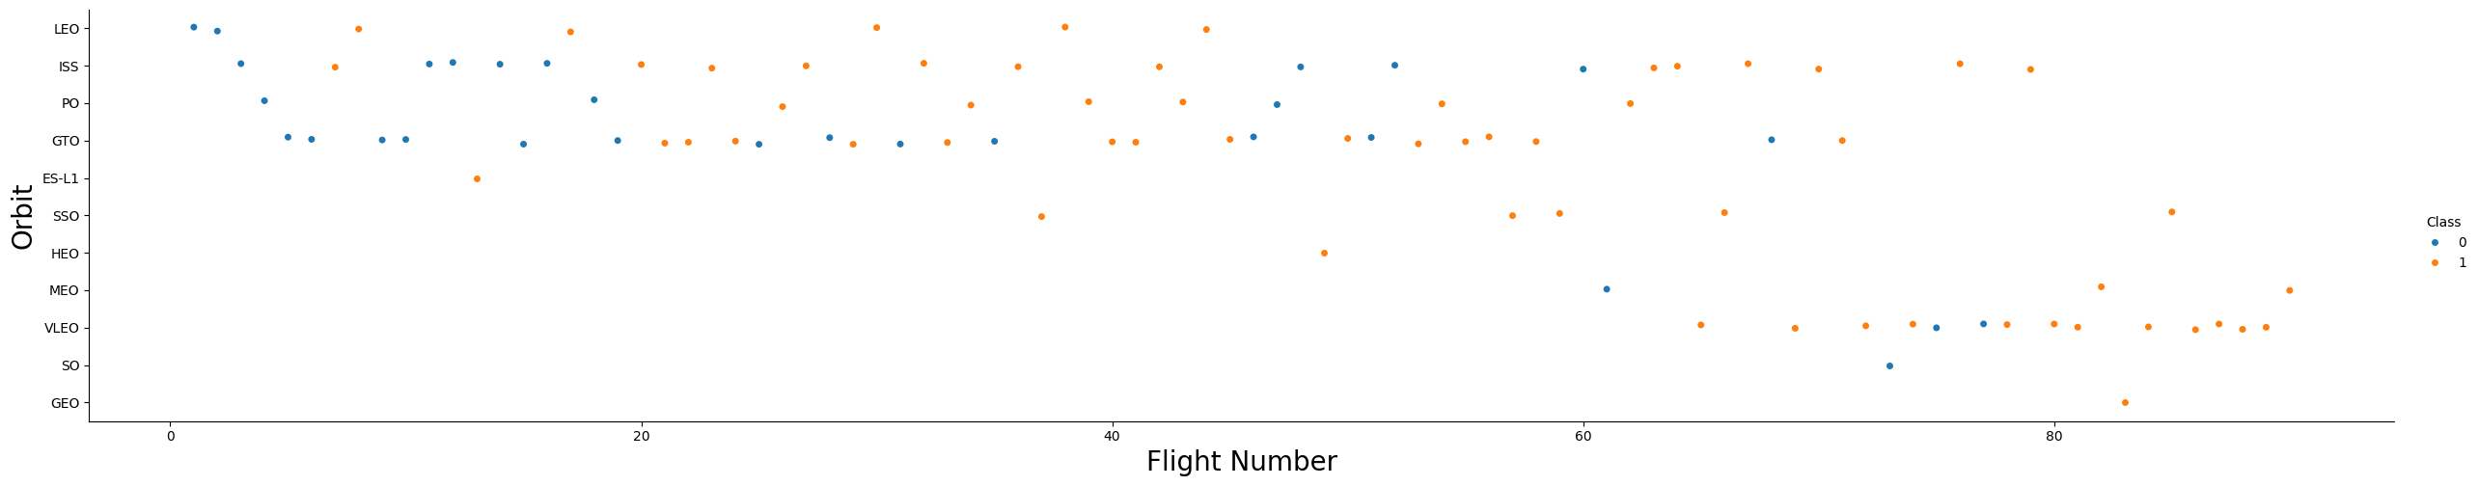
Flight Number vs. Orbit Type

Slide 21
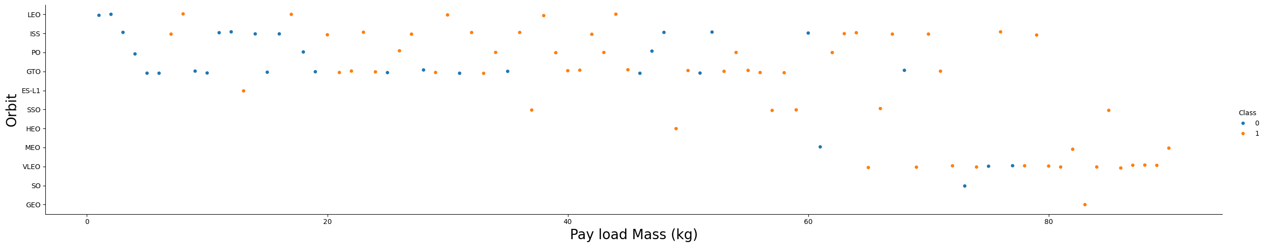
Payload vs. Orbit Type

Slide 22
Launch Success Yearly Trend

Slide 23
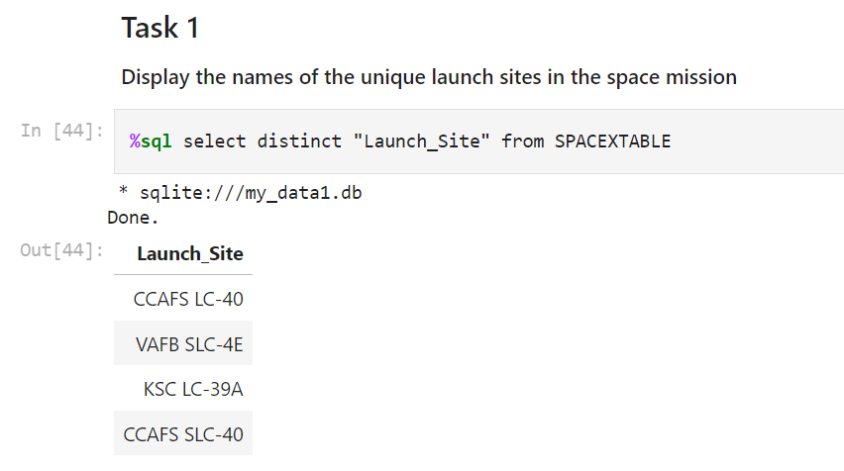
All Launch Site Names

Slide 24
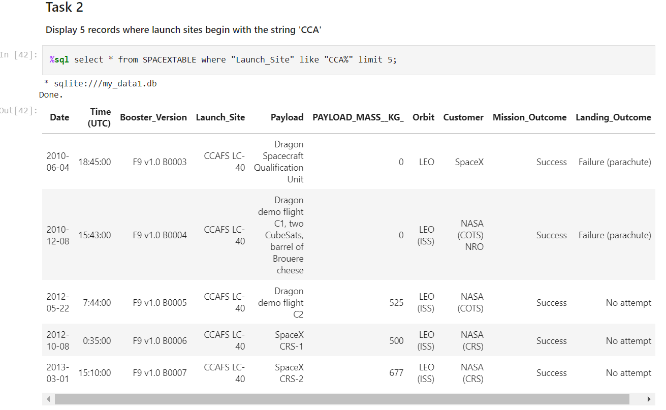
Launch Site Names Begin with 'CCA'

Slide 25
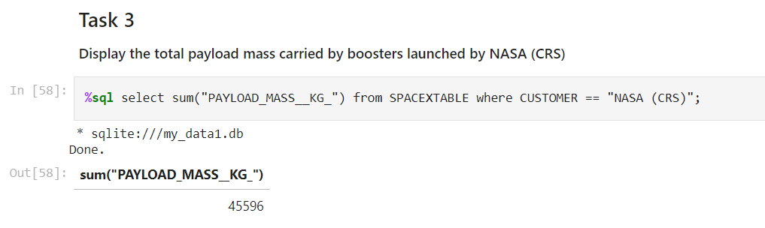
Total Payload Mass

Slide 26
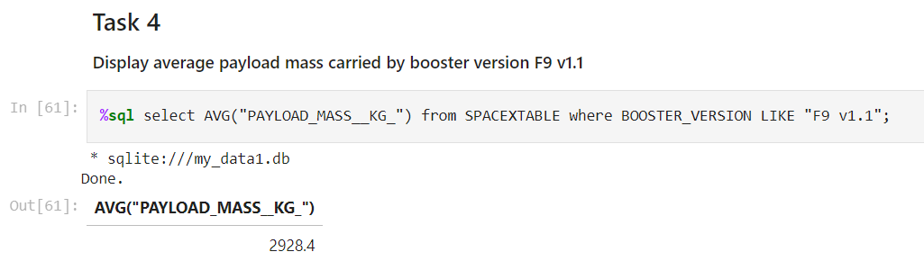
Average Payload Mass by F9 v1.1

Slide 27
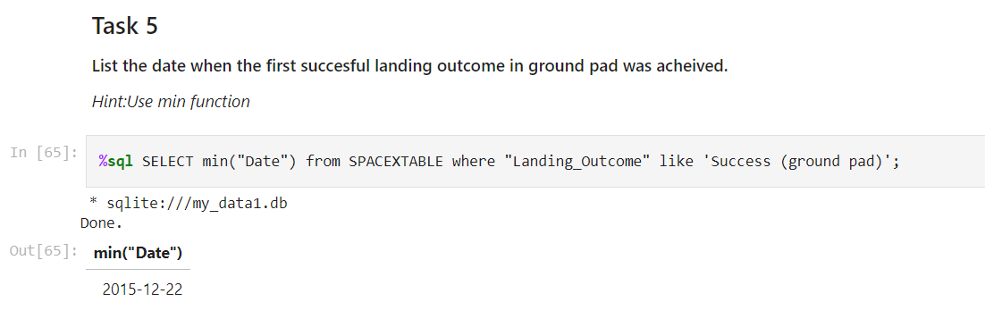
First Successful Ground Landing Date

Slide 28
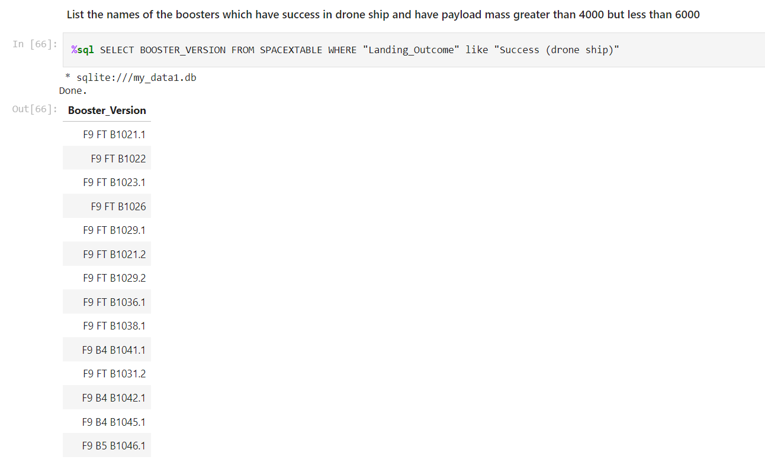
Successful Drone Ship Landing with Payload between 4000 and 6000

Slide 29
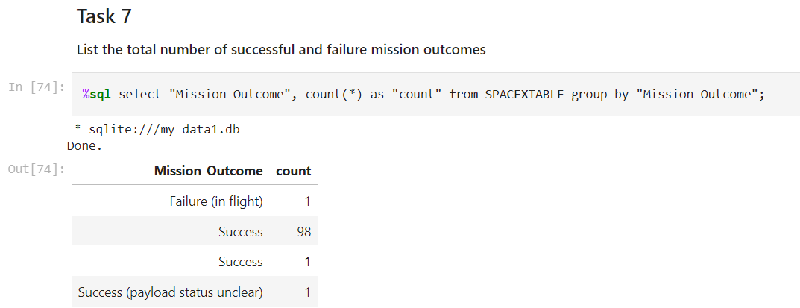
Total Number of Successful and Failure Mission Outcomes

Slide 30
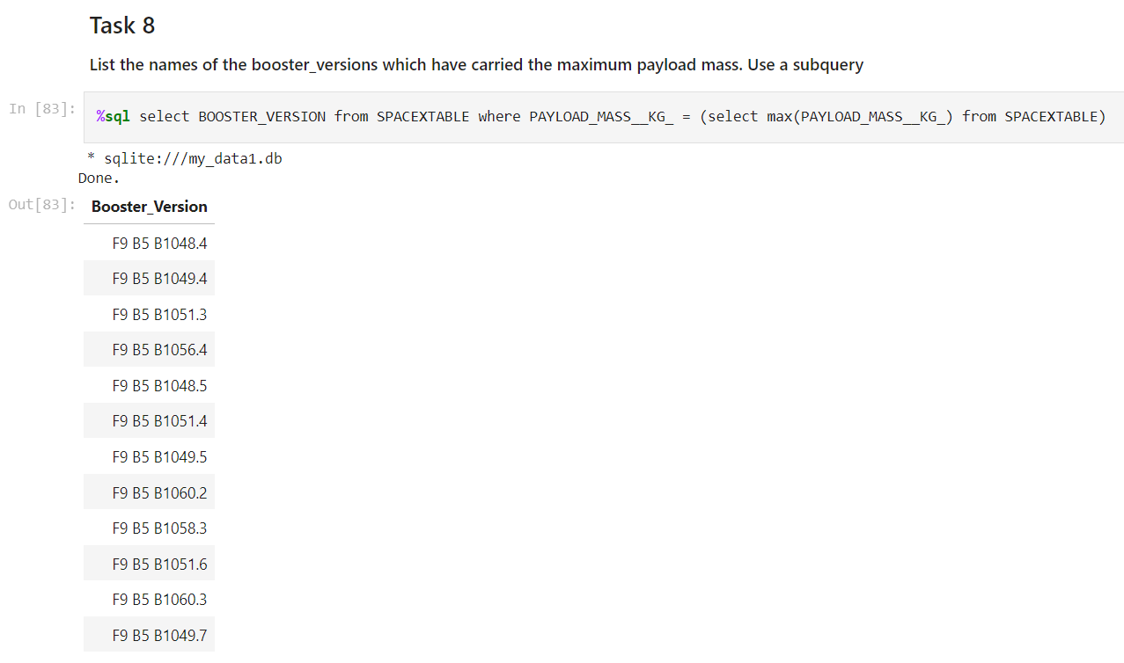
Boosters Carried Maximum Payload

Slide 31
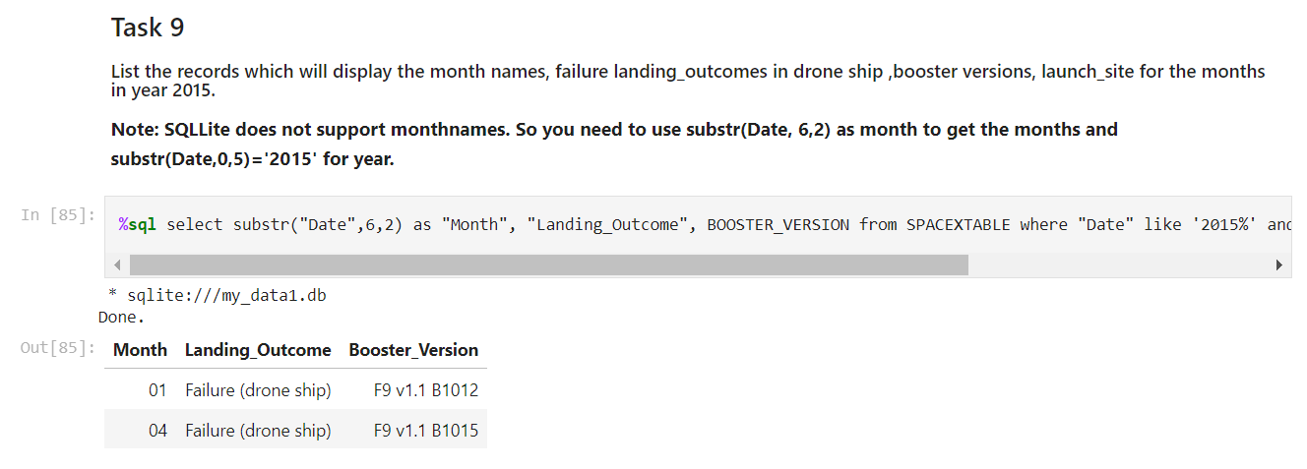
2015 Launch Records

Slide 32
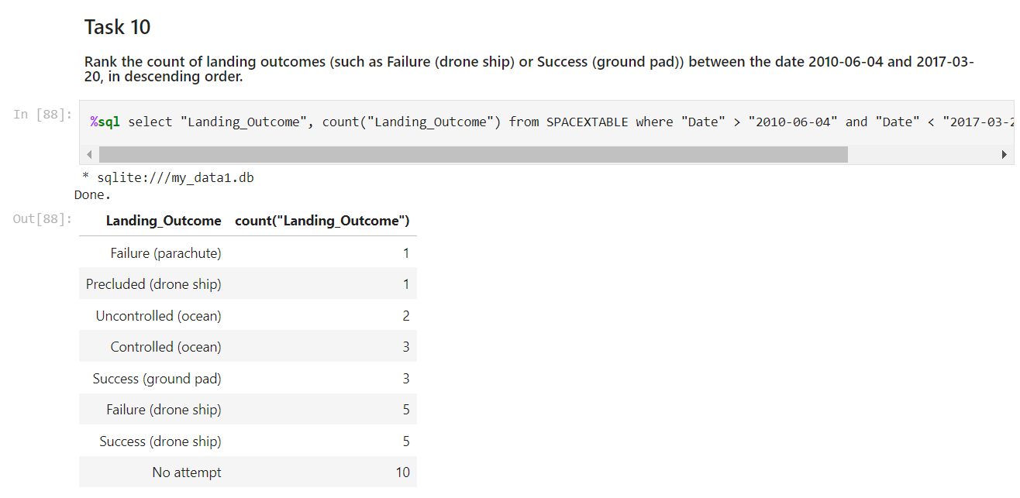
Rank Landing Outcomes Between 2010-06-04 and 2017-03-20

Slide 33

Section 3

Slide 34
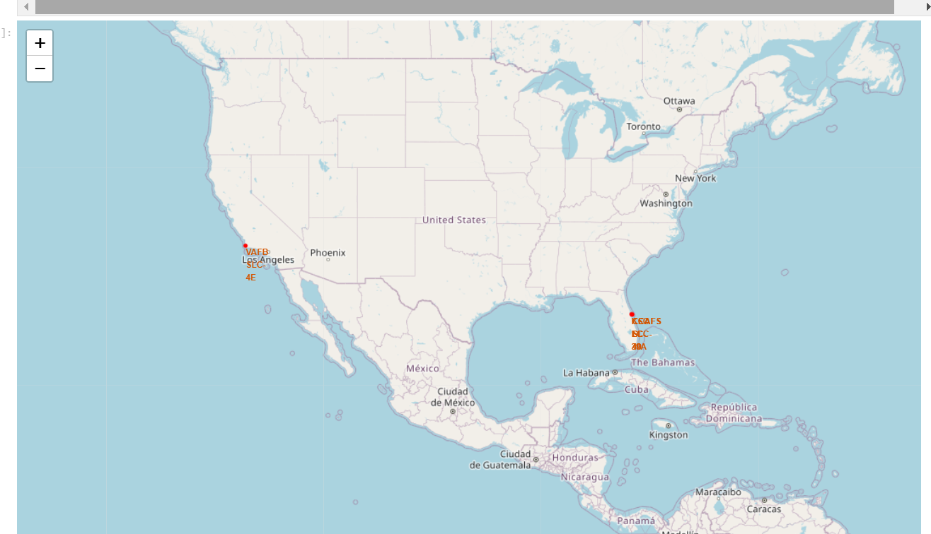
Launch Sites

Slide 35
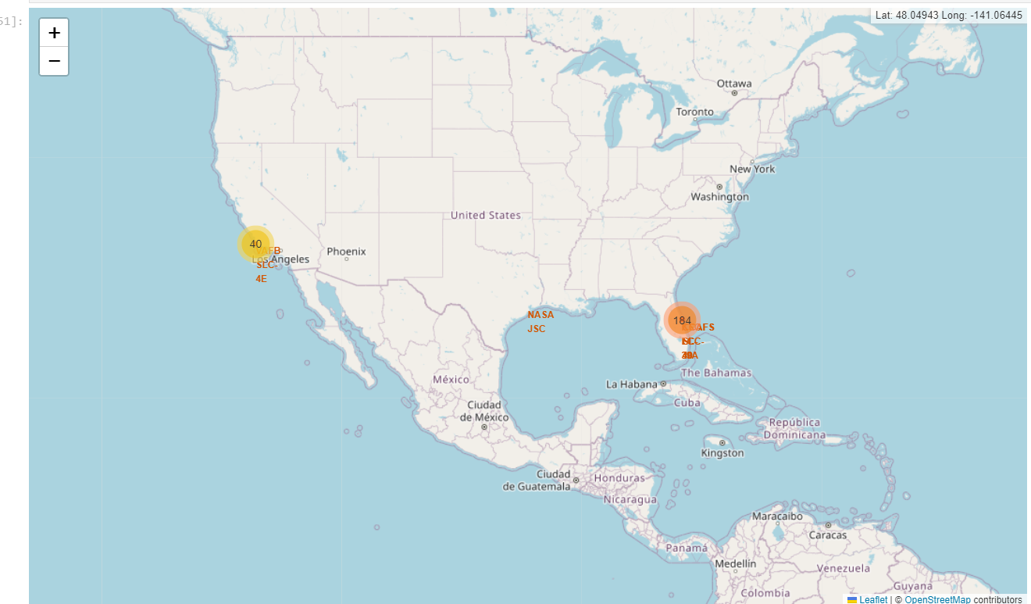
Success Rate of launch sites

Slide 36

Section 4

Slide 37
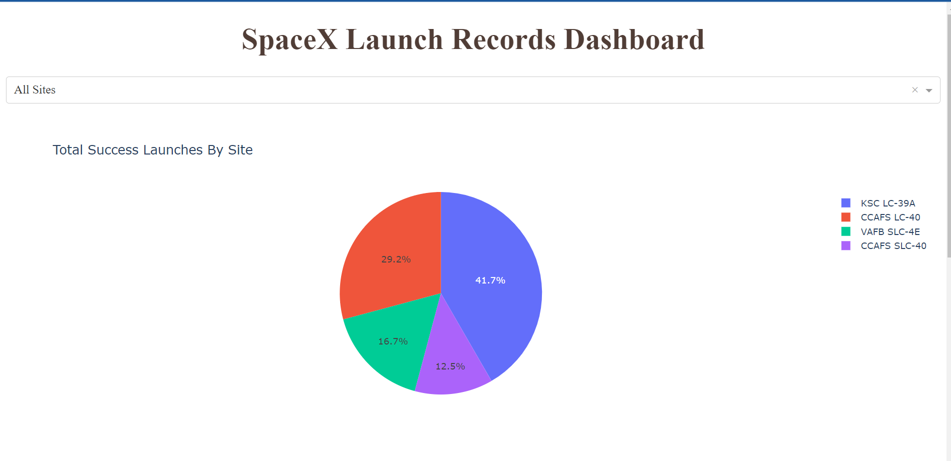
Total Success Launches By Site

Slide 38
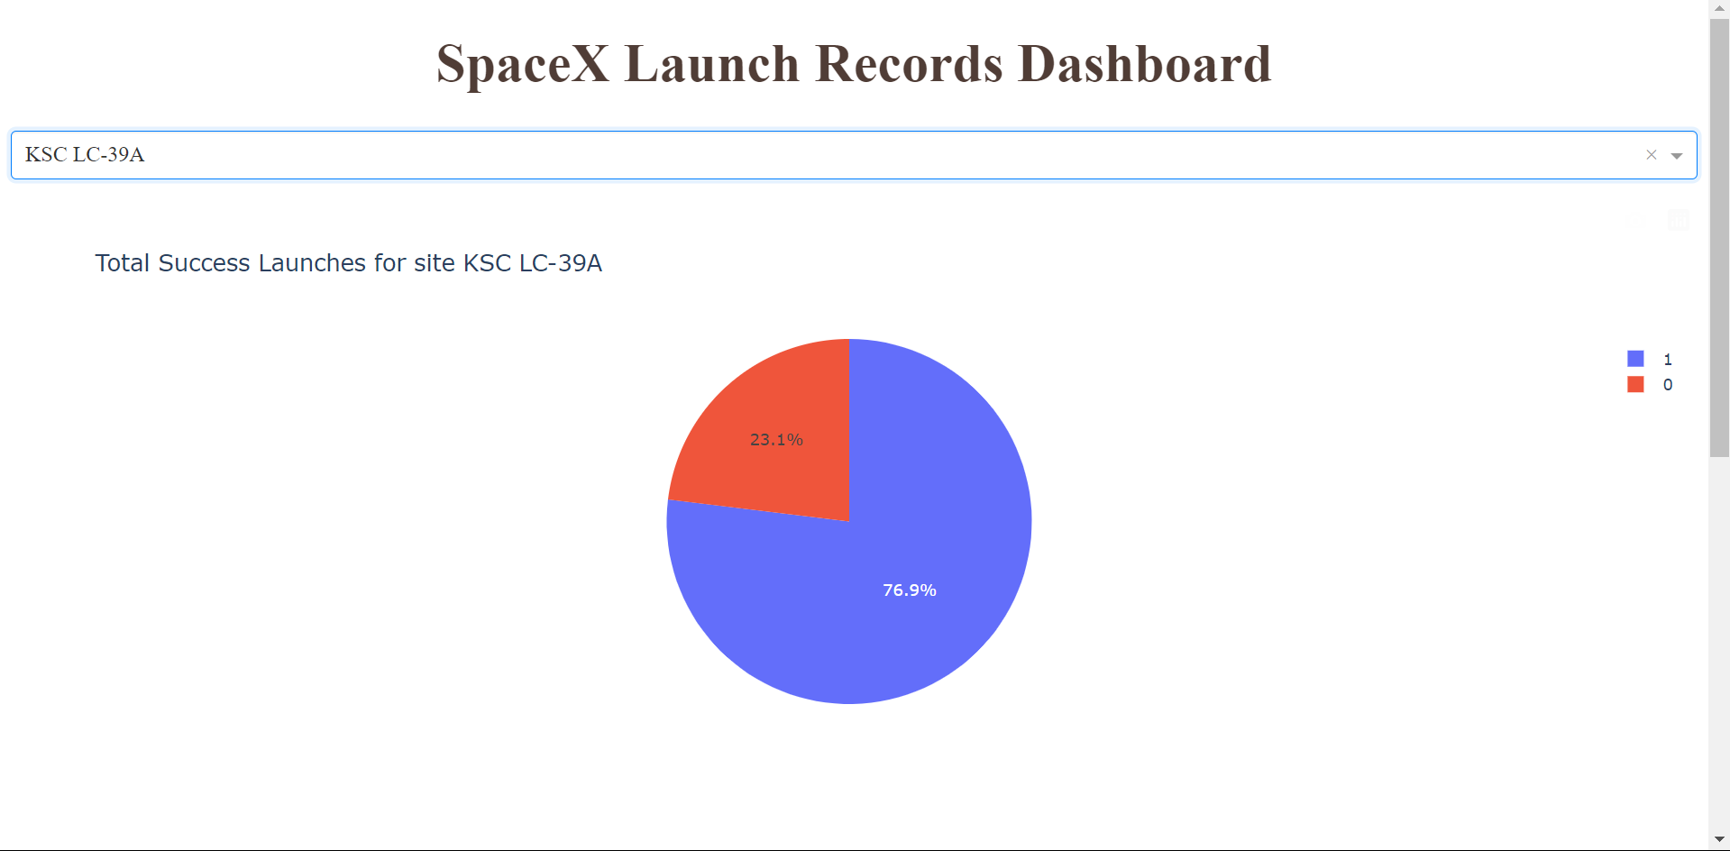
Total Success launches by KSC LC-39A

Slide 39
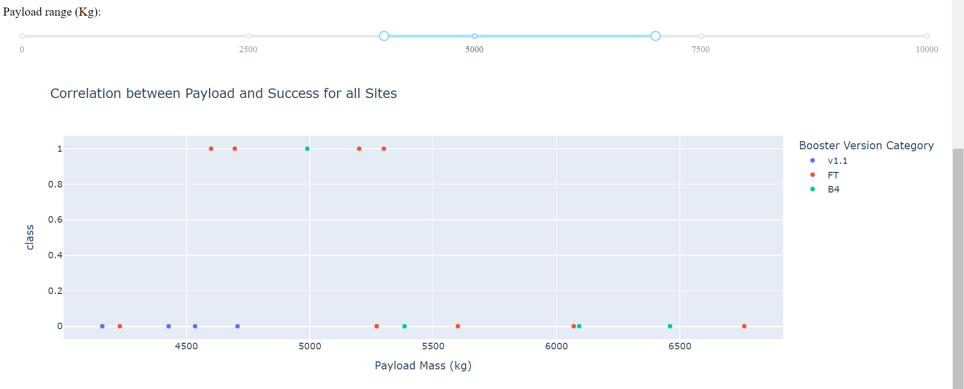
Payload vs Success Rate

Slide 40

Section 5

Slide 41
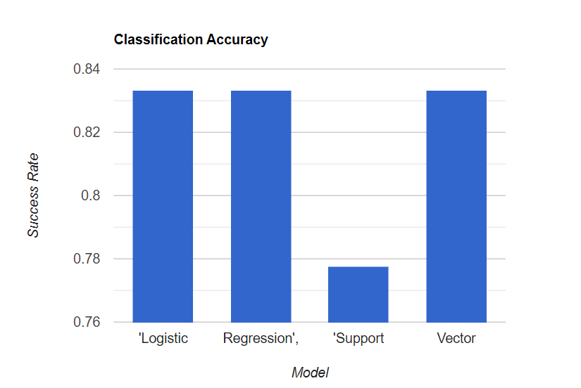
Classification Accuracy

Slide 42

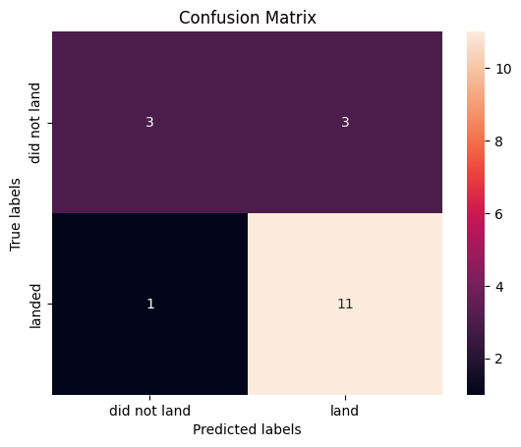
Confusion Matrix

Slide 43


